Slide 1
Hazard Issues in China
First Technical Workshop on Standards for Hazard Monitoring, Data, Metadata and Analysis to Support Risk Assessment
Guofu Wang
National Climate Center(BCC), CMA
11 June, 2013

Slide 2
BCC’s mission & functions
Organization structure
Missions
Climate Monitoring Division
(CMD) 19 FTE
To monitor and diagnose global atmospheric and oceanic conditions, as well as significant climate events , especially in East Asia
National Climate Center(NCC)
Beijing Climate Center (BCC)
There are 8 operational divisions and 3 administrational offices, and about 200 staffs, responsible for the climate monitoring, prediction, and disaster assessments.
In center more than half of staffs are directly involved in climate services and disaster issues.
Climate Prediction Division
(CPD) 19 FTE
Climate Impact Assessment Division
(CIAD) 21 FTE
General Office (GO)
6 FTE
To issue global climate predictions and impact assessments at monthly, seasonal and inter-annual time scales, particularly in East Asia
Climate & Climate Change Services Division
(CSD) 10 FTE
Division of Operation, Science and Technology (DOST)
7 FTE
Climate System Modeling Division
(CSMD) 24 FTE
Climate Change Adaptation Division
(CCAD) 14 FTE
To provide climate services to different users
Division of Personnel Affairs (DPA)
4 FTE
Laboratory for Climate Studies
(LCS) 10 FTE
To do research on climate and climate change issues
Operational System Management Division
(OSMD) 15 FTE

Slide 3
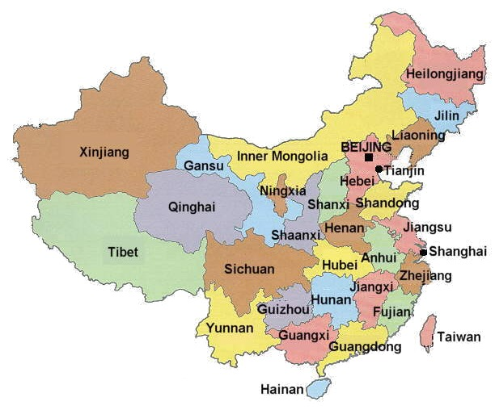
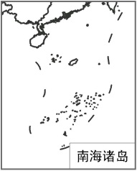
BCC’s mission & functions
National and 31 provincial Climate Centres are engaged in climate operations, research and services, in China.
The two level official organization are the foundation in the operations tier.
All of the centers established the CS operational system, according to the missions.
31 Provincial Climate Centres with almost the same organization struc. and mission
The two level official organizations, national and provincial, are also the foundation of hazard and disaster operations tier in China.
Notes:
There are 31 provincial Climate Centres, to provide service for regional governments, business and so on.
The two level official organization , national and provincial, are the foundation in the operations tier.

Slide 4
The brief difference
 | NCC(BCC) | Provincial Centers | Local Admin.
Users | decision-makers (government) major projects researchers the public | sectors(industry) local government the public | enterprise local government
Products | climate prediction climate monitoring climate bulletin impact assessment disaster risk consolidated report … | local prediction special report consultation report climate condition assessment for projects strategic advice … | climate normal early warning consultation report climate condition assessment for local projects
Focus | climate predict climate change adapt… | the need of industry agriculture, water source insurance wind energy impact assessment | warning and response for adaptation

Slide 5
Outline
Disasters in China
BCC Products
Disaster Risk Management
Development Of data Resources
Notes:
My presentation’s outline. There are four components

Slide 6
Outline
Disasters in China
BCC Products
Disaster Risk Management
Development Of data Resources

Slide 7
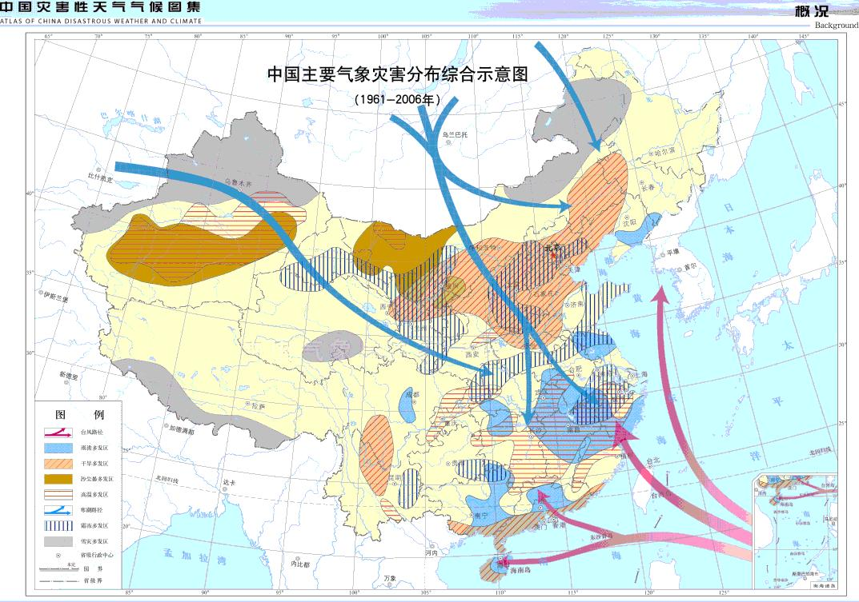
Disasters in China
Northwest region: drought, sand storm, cold surge
Northeast region: cold surge, flood, drought
There are many kinds of meteorological disasters in whole China, with wide range, heavy intensity and severe damage. Global warming would enhance the frequency of extreme weather disasters.
long-range, unexpected, complicated
Tibet Plateau: Hailstone, snowstorm
North district: drought, cold surge
Southwest region:
heat wave, drought, landslide and debris flow caused
by flood
Yangtze-Huaihe region: flood, typhoon, thunderstorm, gale, tornado
South district:
typhoon, flood, drought

Slide 8
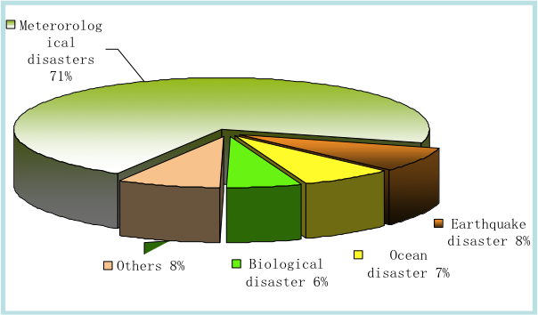
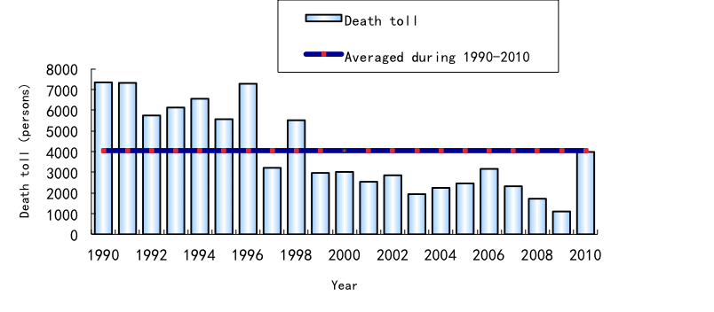
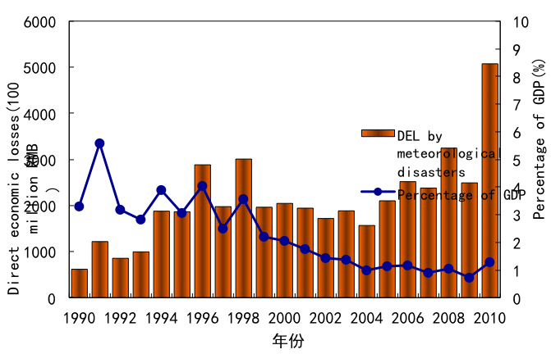
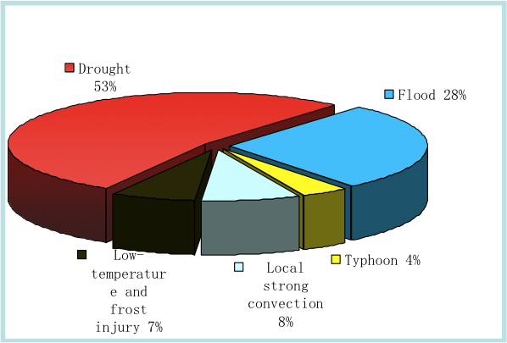
Disasters in China
Meteorological disasters occur frequently with great losses in China
Great influence and heavy losses in meteorological disasters
About 4000 killed
Drought and flood are the major contributors
2.37%
More than 200 billion Yuan

Slide 9
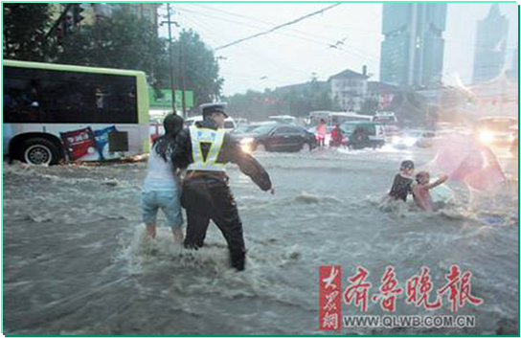
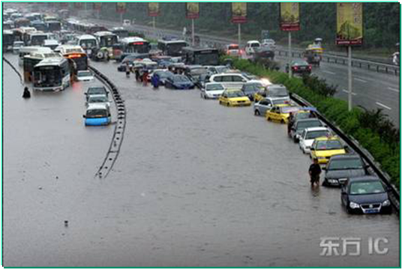
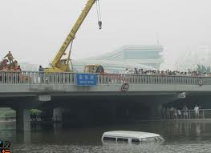
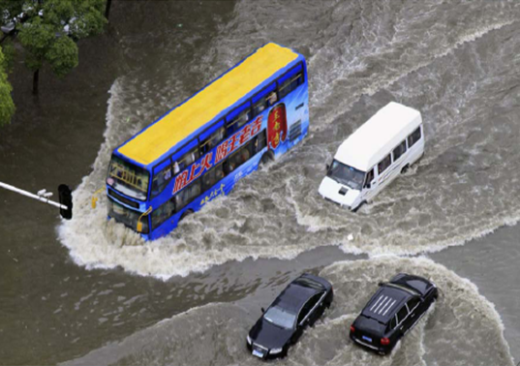
Disasters in China
City flood
New focus and definition
2007.7.18, Jinan
2007.7.17, Chongqing
2011.6.23, Beijing
2011.6.18, Wuhan

Slide 10
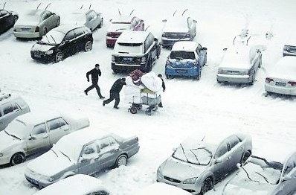
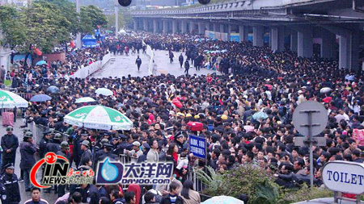
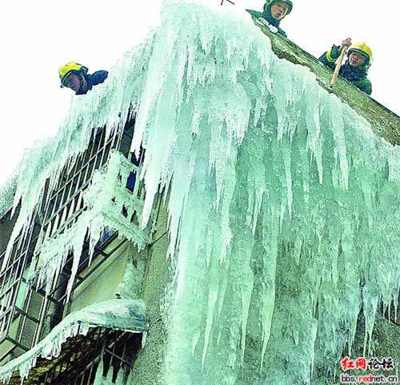
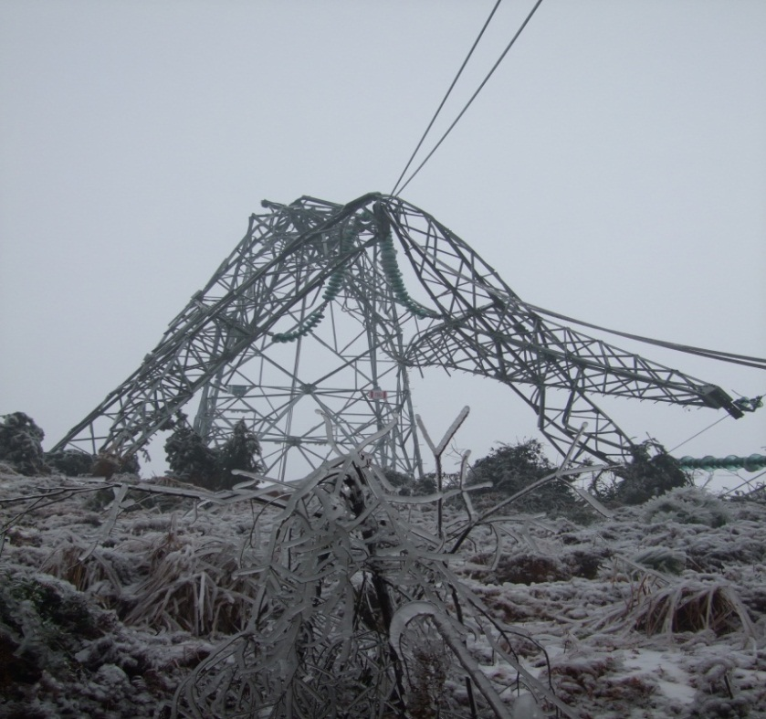
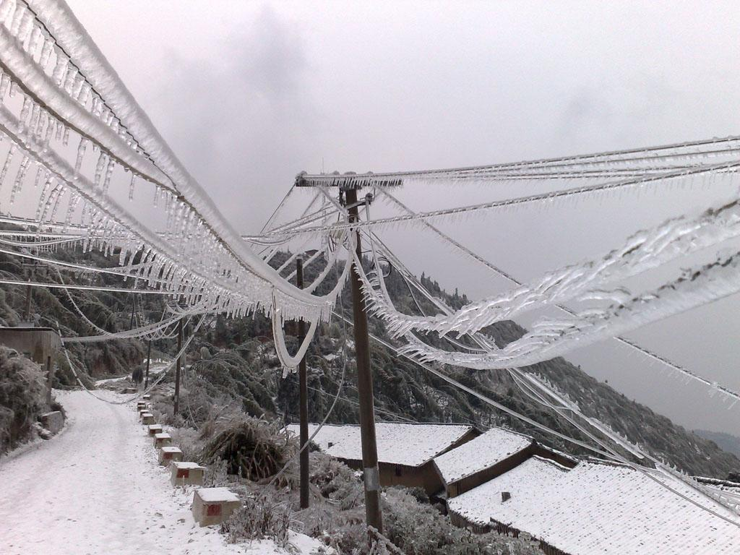
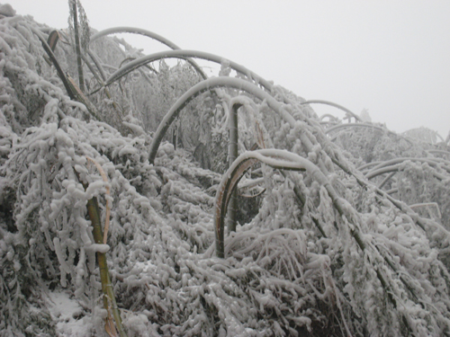
Disasters in China
Cold Surge, Ice-snow and Frozen Disasters in South China in 2008
During Jan. 10th to Feb. 2nd , Rare cold Surge, ice-snow and frozen Disasters attacked most parts of China four times, especially South China, with a feature of large damage range, heavy intensity, and long duration.
Large coverage
公路结冰交通受阻
旅客滞留车站
生活受影响
电塔倒伏
电线结冰
树木受毁
Notes:
10

Slide 11

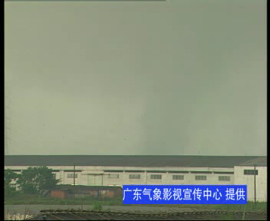
Disasters in China
Tornado
Long trace
There are about 100 tornado occurs every year on average. On Jul. 3, 2012, Tianchang city of Anhui province and Gaoyou, Huaian, Yancheng, and Xinghua of Jiangsu province attacked by tornodo.14 killed, and 196 injured.
Notes:
11

Slide 12

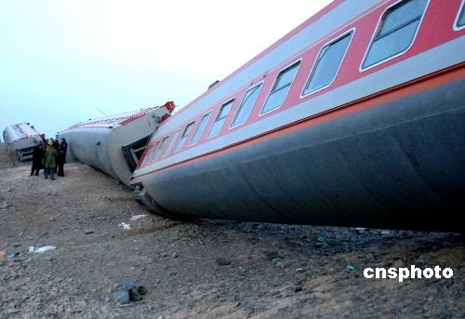
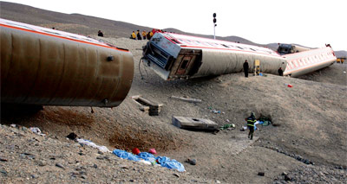
Disasters in China
Gale
Train derailed
In Apr.9th 2006, T70 train was attacked by strong sandstorm (12 level winds) when travelling in east of Xinjiang province.
In Feb 28th, T5807 train was turned over by 13 level winds with several killed and injured.
Extreme events
Notes:
12

Slide 13
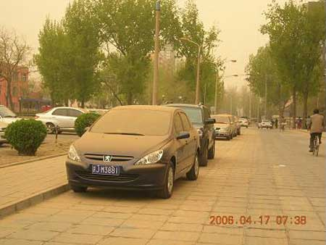


Disasters in China
In Apr.16th-18th 2006，after one severe sandstorm, In Beiing, the total of dust fall down are about more 300,000 tons on 16th night.
New requirements

Slide 14
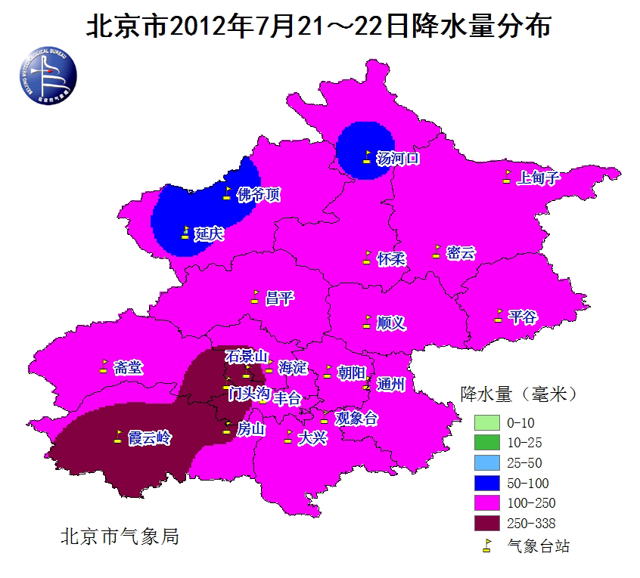
The strongest rainstorm in Beijing on July 21, 2012
Disasters in China
The daily average rainfall is 190 mm with the maximum 460 mm at Fangshan
The hourly rainfall exceeded 100 mm at Huairou.
The daily rainfall broke the historic records at 11 stations.
Real-time
Daily rainfall distribution in Beijing on July 21
Notes:
14

Slide 15
Outline
Disasters in China
BCC Products
Disaster Risk Management
Development Of data Resources
Disaster Monitoring and Detection
Hazard Analysis

Slide 16
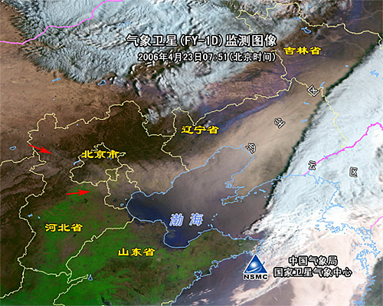
Disaster Monitoring, Detection & Analysis
Dust storm
Disaster Prediction for May-Sept., 2013
Drought trend

Slide 17
Disaster Monitoring, Detection & Analysis
Drought
2013

Slide 18
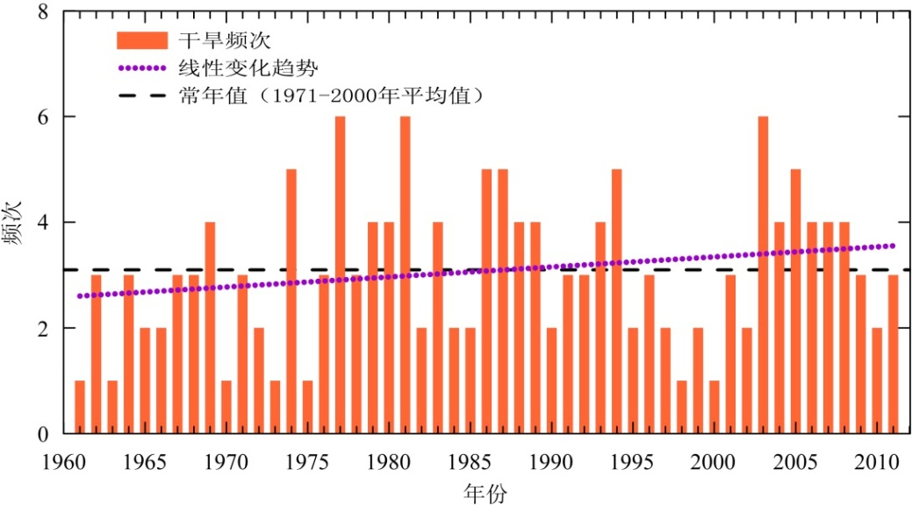
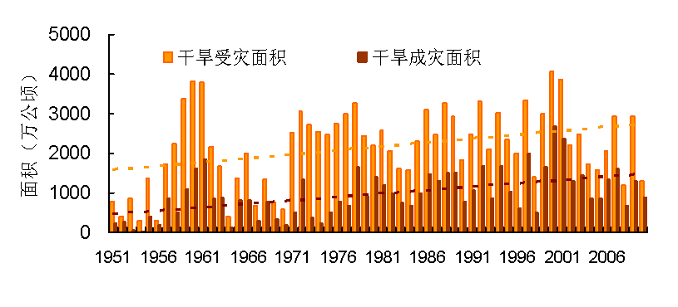
Disaster Monitoring, Detection & Analysis
Drought
An increase trend of Agriculture damage area by drought. The drought area are about 10 million hectares per year in average
Frequency of regional drought event
have increased since 1961

Slide 19
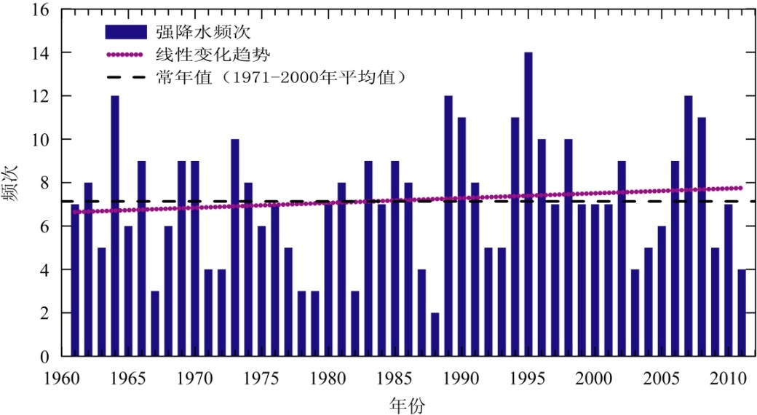
Disaster Monitoring, Detection & Analysis
Rainstorm flood
In China, 40% population, 35% cultivated land and 60% industrial and agricultural output are threatened by flood. The damage of grain by flood is next only to drought，and the annual grain loss by flood accounts for 25% of total.
Since 1961, regional heavy rainfall event presents an increase trend
In recent 60 years, it shows a significant increase trend of crops damage area by rainstorm flood, with the max in 1990

Slide 20
Disaster Monitoring, Detection & Analysis
cold day and snow disaster
The crops damage area by cold surge and snow disaster shows an increase tendency. Since 1972, the average of annual damage area is more than 3 million hectares, with the max of about 15 million hectares (2008), and min of about 200,000 hectares (1973). During 1951-2004, there are nearly 400 national and regional cold wave, and annual loss of rice is about 3-5 billion kg.

Slide 21
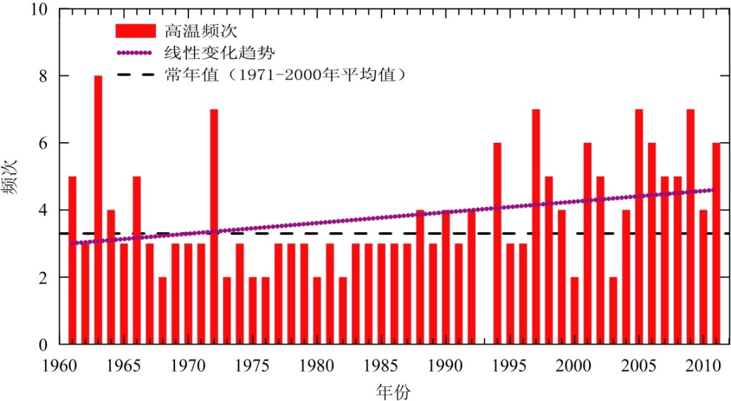
Disaster Monitoring, Detection & Analysis
high temperature and heat wave
An increase trend of regional high temperature events since 1961. High temperature in the region south of the Yangtze River and South China caused a loss of rice. The significant warming and drying in Northwest China added frequency of dry-hot wind, and bring huge damage to agriculture.

Slide 22

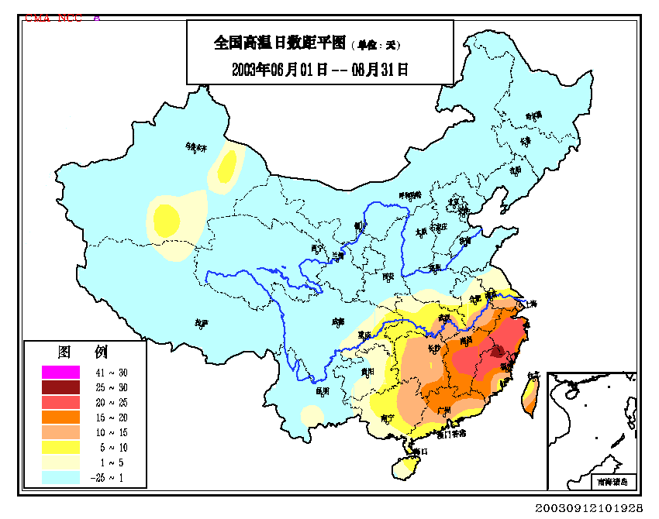
Disaster Monitoring, Detection & Analysis
Hot days
>20days

Slide 23
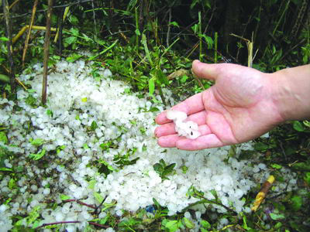
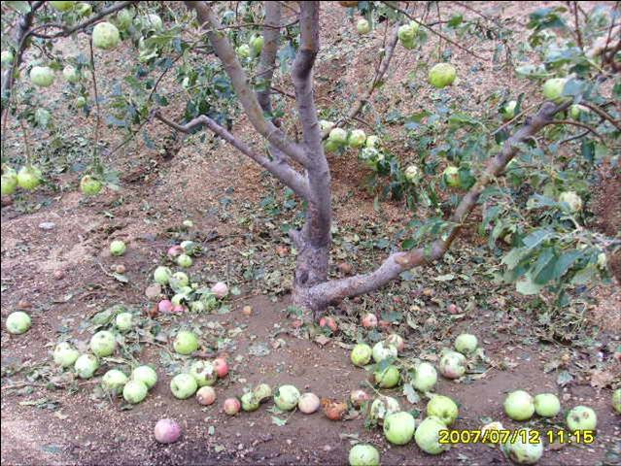
Disaster Monitoring, Detection & Analysis
Hailstone
The average of annual crops damage area is about 4 million hectares. In 2002 the damage area is maximum in past 60 years
（ 1967-1969 data missing）

Slide 24
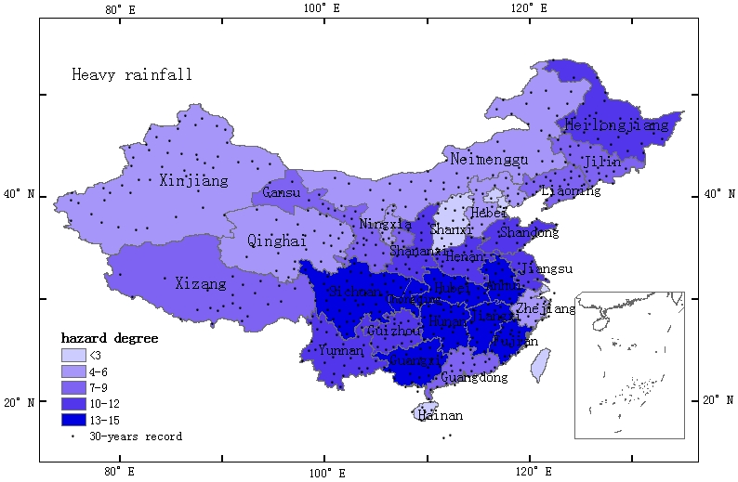
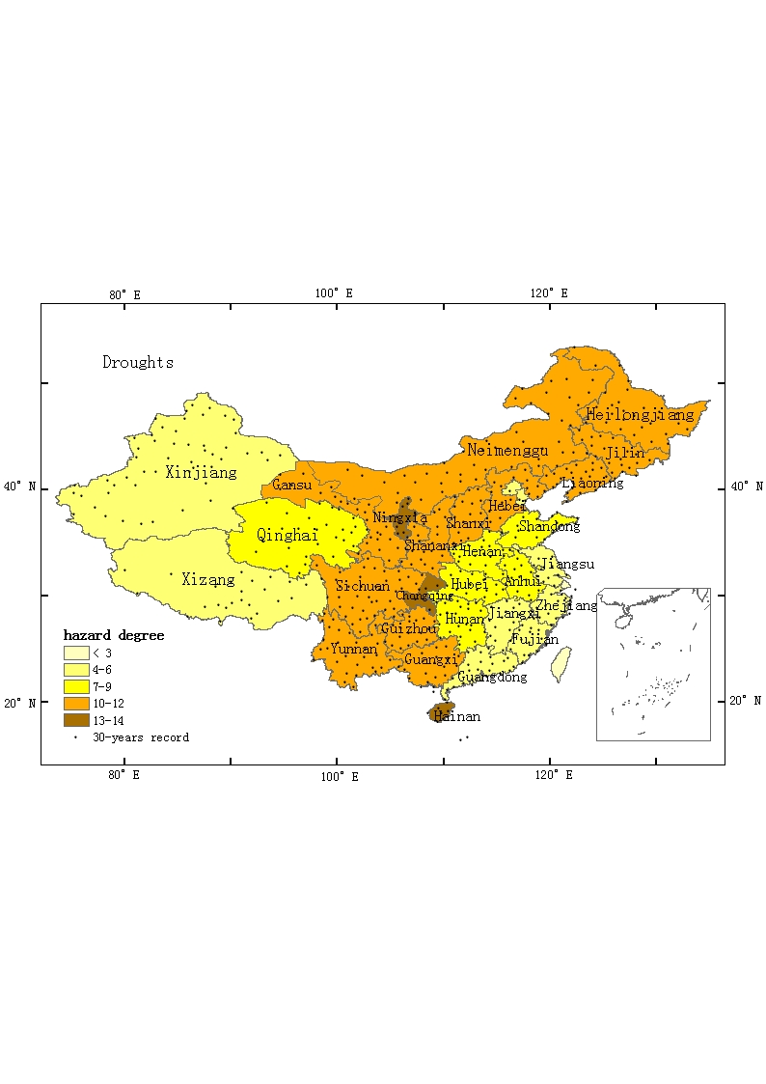
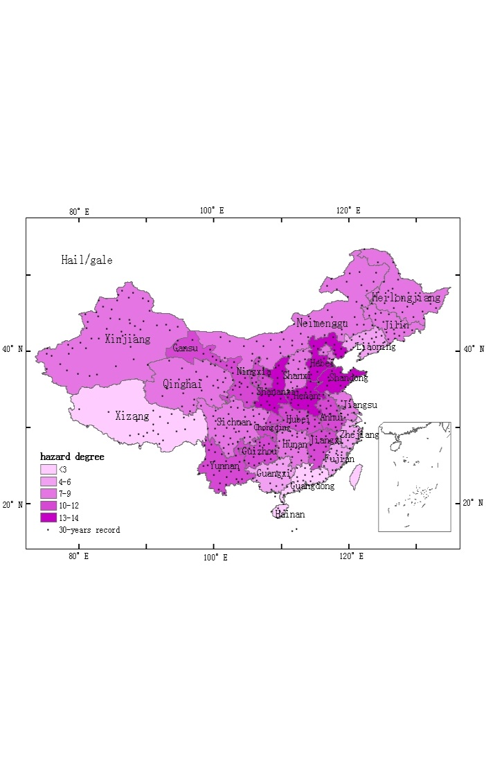
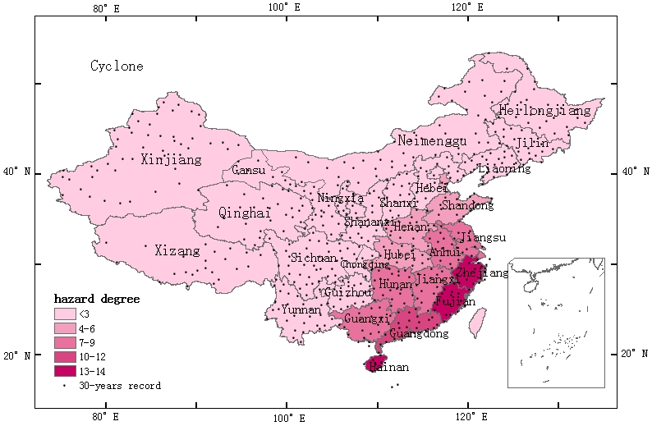
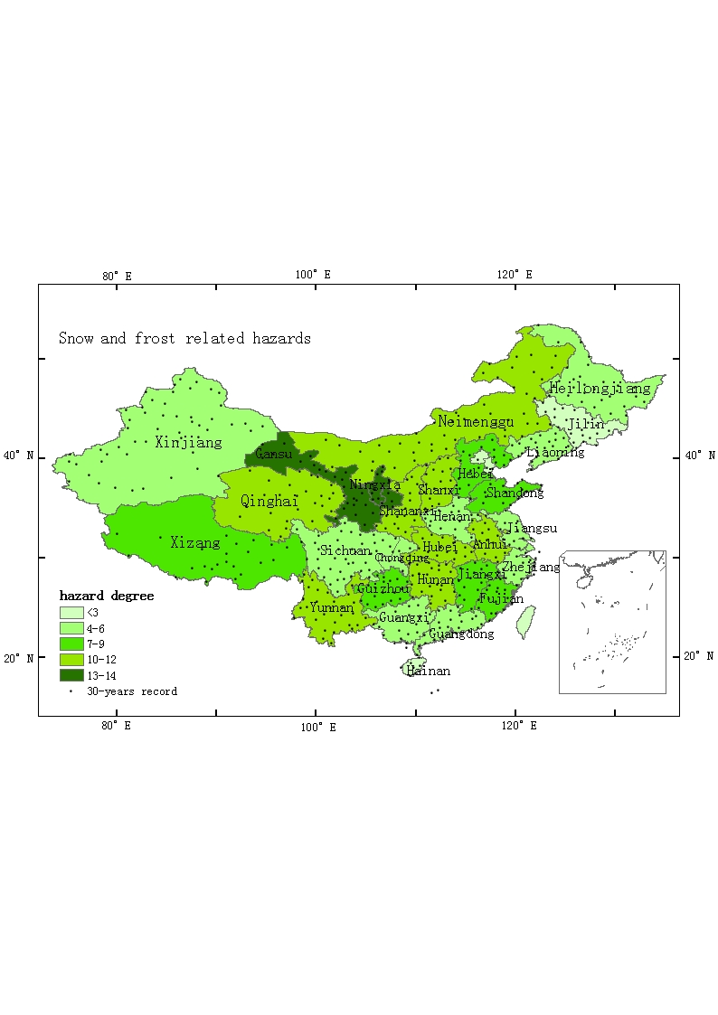
Disaster Monitoring, Detection & Analysis
Risk Mapping for Heavy Rainfall, Drought, Hail/gale, Cyclone and Snow/frost

Slide 25
Outline
Disasters in China
BCC Products
Disaster Risk Management
Development Of data Resources
The Way We Work

Slide 26
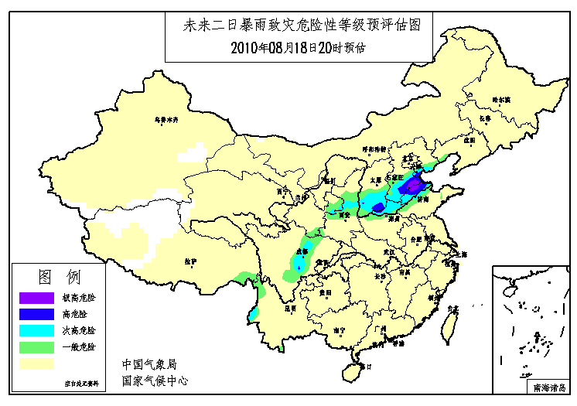
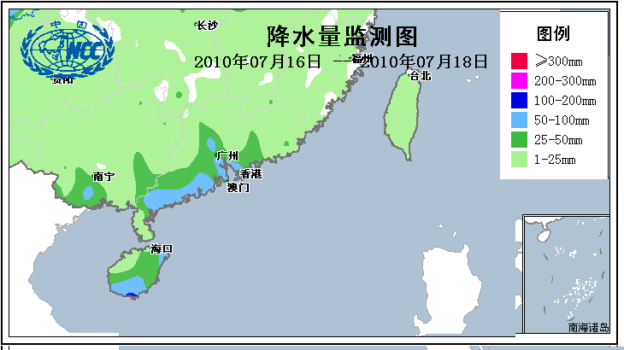
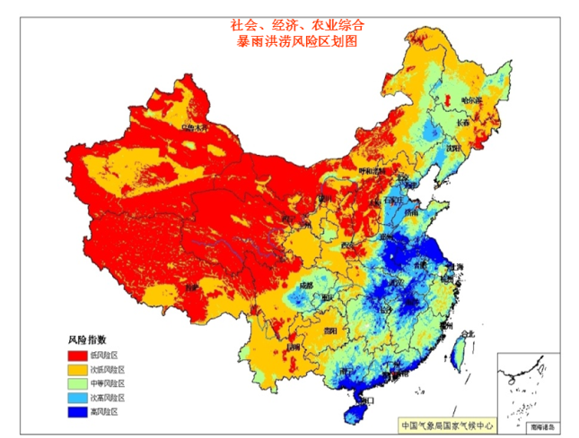
Analyses hazard and provides information
Disaster monitoring, detection and forecast
Assess vulnerability to climate disasters
Establish meteorological disaster assessment system
Publish alert information
《Meteorological Disaster Risk Management Approach》&《Technical Guidance on Meteorological Disaster Risk Assessment》
……
Rainstorm Hazard Risk Assessment
Rainstorm Hazard Risk Assessment Induced By Typhoon
Heavy Rain and Flood Risk Zonation

Slide 27

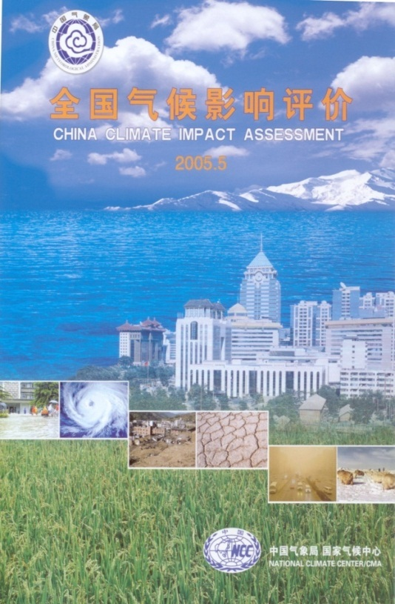
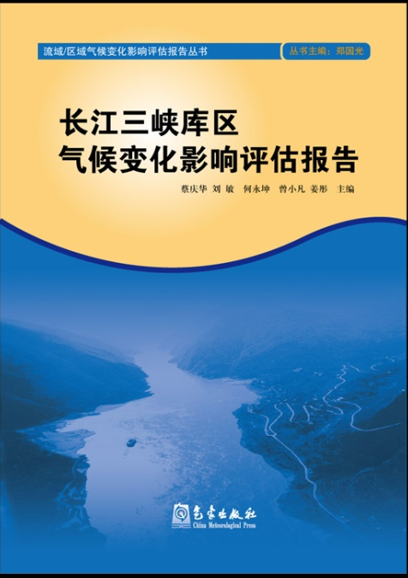
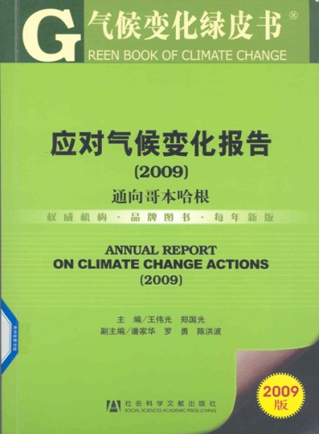
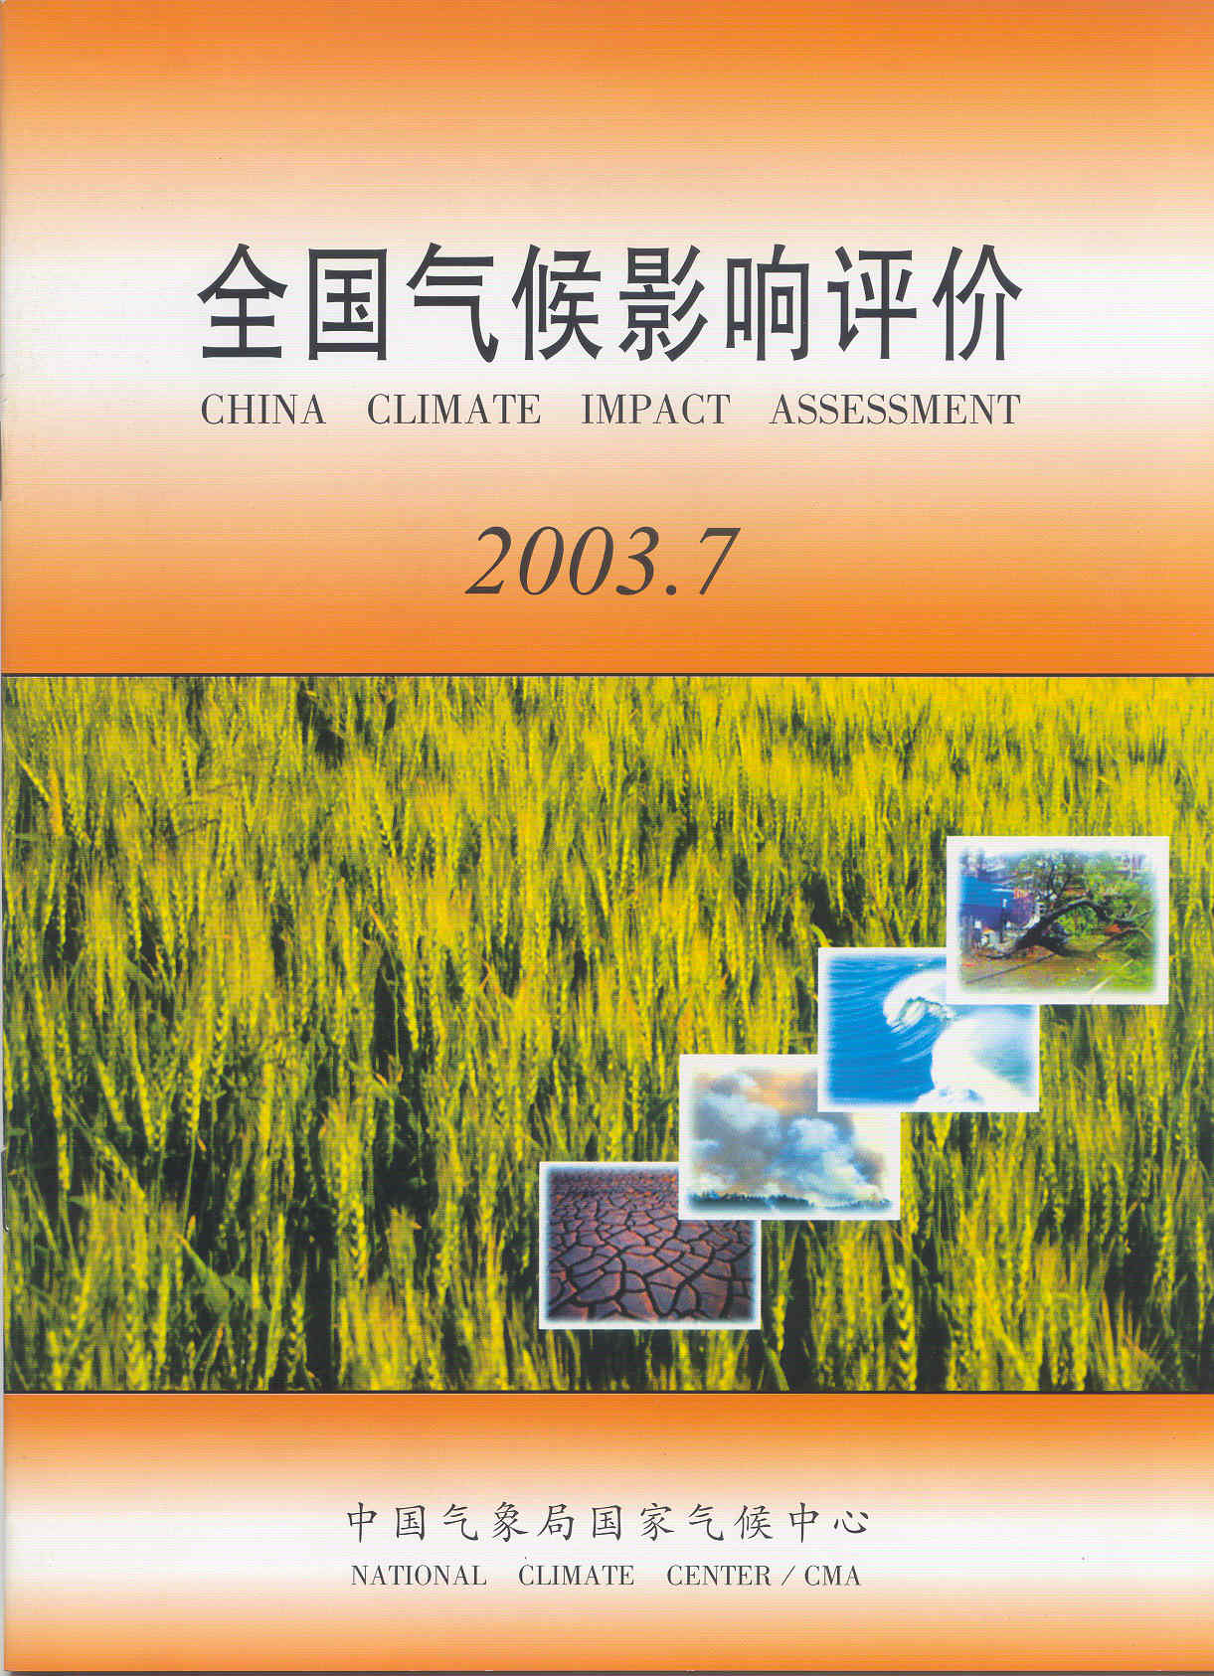
Reports on China Climate and Climate Impacts
China Climate Bulletin
Climate Impact Assessment
  Climate and agriculture
  Climate and water
  Climate and energy
  Climate and transportation
  Climate and human health
  Climate and air quality

Slide 28
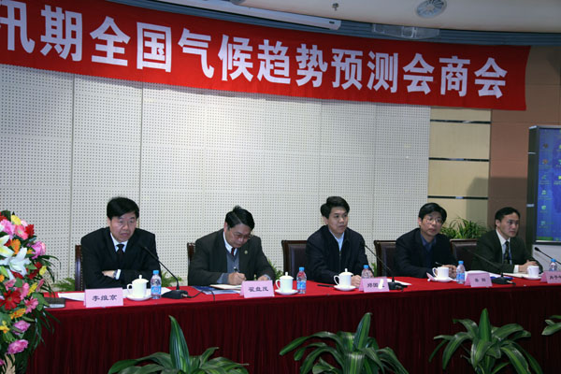
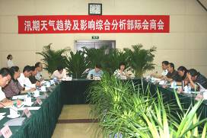
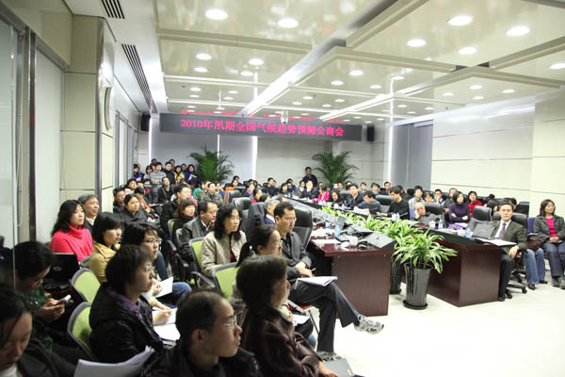
The Way We Work
Cooperation
CMA and Ministry of Land and Resources: geological disasters outlook
CMA and National Forestry Bureau: dust storm climate prediction, seasonal climate rank of forest fire risk prediction ;
CMA and Ministry of Water Resources: climate prediction consulting meeting for summer season;
CMA and Ministry of Agriculture: early frost prediction for autumn season and its impacting assessment ;
…...
Notes:
NCC has good relationship with many users such as Ministry of Water Resources, Ministry of Agriculture, National Forestry Bureau and Ministry of Land and Resources. We jointly issue climate predictions and climate impact assessments.

Slide 29
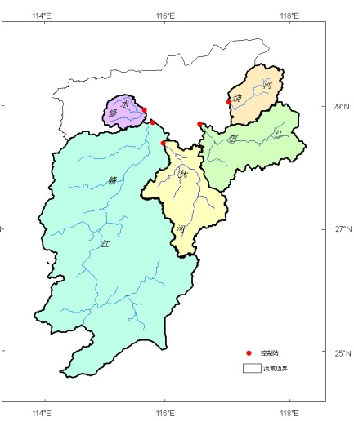
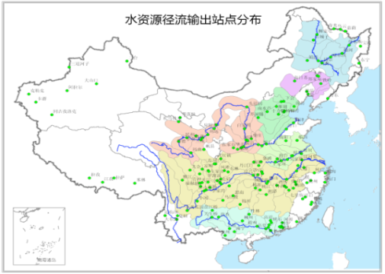
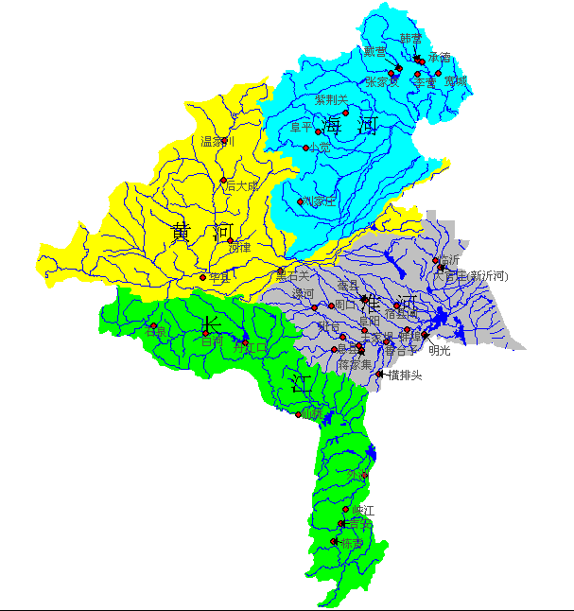
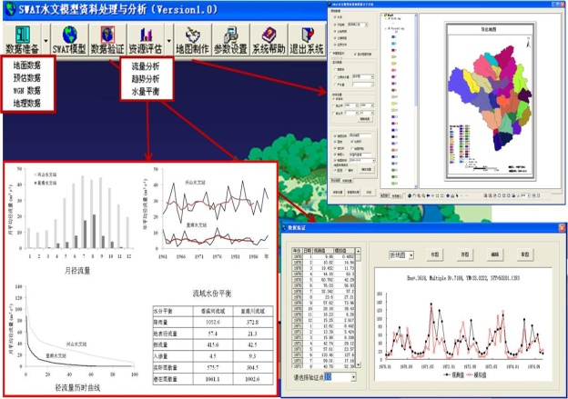
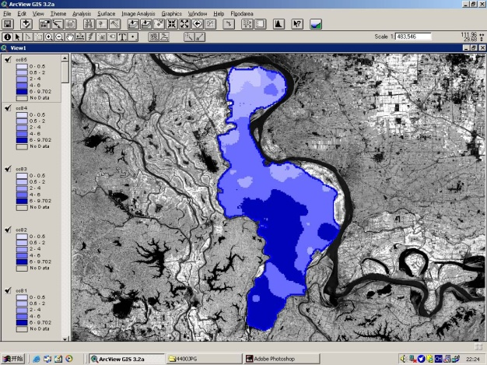
The Way We Work
HBV –Large River Basin
Monthly Water Balance Model – Four Basins
VIC –National Scale
The products of Ministry of Water Resources
SWAT –Typical Mesoscale Basin
Floodarea – Flooding
Notes:
国家气候中心已经基于多个水文模型开展全国、大流域、中尺度流域和洪水淹没等不同时空尺度的水资源及旱涝灾害评估。
29

Slide 30




The Way We Work
Weekly predictions on dryness
and wetness in China Asia and World
The products for the Ministry of Agriculture
Climate impact on agriculture
2011年中国≥10℃积温距平分布 （度·日）
作物模型模拟的2011年冬小麦产量距平百分率（%）

Slide 31




The Way We Work
Developed/ing information-sharing platform
Meteorological data sharing service system
Special network connection with 14 sectors
Exchanging data with user sectors daily and real-time
CMA sponsored the early warning dissemination system for the meteorological disasters

Slide 32


The Way We Work
Education and training for key users
CMA is authorized by the central government to host 2-3 training courses each year, which participated by city mayors nationwide;
CMA regularly trains the voluntary weather and climate information deliverers (total 550,000);
Township leader training program has been kicked off as a pilot project in 2010;
As a RCC in Asia area, hold the Forum on Regional Climate Monitoring, Assessment and Prediction for Asia (FOCRAII) every year;

Slide 33


The Way We Work
user interface
Early Warning Information Center for Media
Press conference every month
Media is a driving force for climate service delivery and disaster risk reduction, communication and outreach are essential for ensuring consistent warning and a single official voice ( against wrong info and rumors)
China Weather TV

Slide 34
Outline
Disasters in China
BCC Products
Disaster Risk Management
Development Of data Resources

Slide 35

Data Resources
Functional observation database system
Include 14 types, more than 500 datasets, and 1500 attributes
Storage volume : on-line 200TB, near-line 2.27PB

Slide 36


Data Resources
（1） The collection of historical disaster information
historical disaster information census project
  (involved: 2300 counties)
The direct economic losses caused by meteorological disasters (1964-2007)
Killed number caused by meteorological disasters (1964-2007)

Slide 37




Data Resources
（2） The update of disaster information
meteorological disaster reporting operational system and database
  (Involved 28 kinds of meteorological disasters, and more than 12 million records)

Slide 38





Data Resources
（3） The development of hazard monitor
integrated meteorological observation system
including：Meteorological satellites, Doppler weather radar, AWS (36181), wind profilers, lightning locator, GPS / MET, the mobile observation equipment and so on.
Notes:
38

Slide 39




Data Resources
（3） The development of hazard monitor
Operational monitoring network collaborated by multi-sectors
Transport
Ocean
Geology

Slide 40
Challenge
Standard
Data and product quality & mass historical data processing
More and more requirements

Slide 41
Questions from Dr. Marymam Golnaryaghi
1. Definition of hazards?
A little
2/3 Institutional aspects/cooperation in hazards issues?
Governmental, eg. BCC/CMA
4. Data management?
Database systems, even in provinces
5. Data sharing in sectors?
- yes

Slide 42
Questions from Dr. Marymam Golnaryaghi
6. Challenges in national level?
- standards, quality, historical data processing
7. Hazard analysis?
- p26-30
8. Operational hazard analysis for climate change?
- only kick-off
9. Delivery models?
- p33 give some examples

Slide 43
Thanks for your attentions!
Comments & questions, please.
Several web sites:
  http://cdc.cma.gov.cn (Chinese version)
  http://bcc.cma.gov.cn/en (English version)
  http://www.weather.com.cn (Chinese version)

